Slide 1
Additional Assignment Resources
Advanced C++ Input/Output

Slide 2
Outline
Architecture of C++ Input/Output
  The hierarchy of C++ I/O classes
  Distribution of responsibilities
Advanced Features of C++ I/O
  Create your own manipulators

Slide 3
Assume
You are already generally familiar with the notion of "stream" I/O in C++.
You have used, in a C++ program, cin to read various kinds of input from the keyboard, and cout to write various kinds of output to the screen.
You have done the analogous thing, in a C++ program, for input from, and output to, a text file of data.
You have used manipulators for additional control over output formatting.

Slide 4
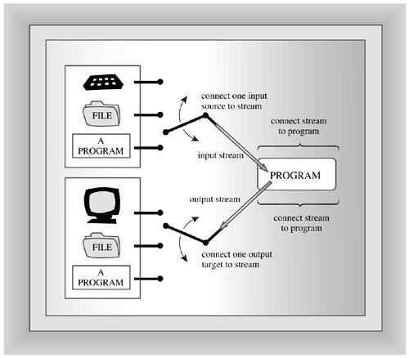
C++ Input and Output
A stream is a common logical interface to various devices

Slide 5
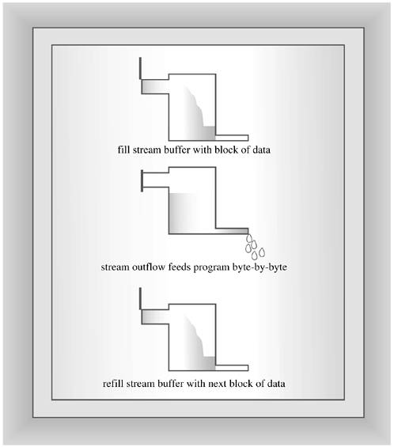
Buffered Input/Output

Slide 6




Input/Output Stream
Source
&
Destination
status
stream
bits
0100100111110001010101011100011… … … … … 11011011
bytes
0100100111110001010101011100011… … … … … 11011011
format
SgpX156.89 … … … … … 3
characters
23.6789
data
123, 1.0e-35, 123.789

Slide 7
Standard I/O Class Hierarchy
ios_base
has-a
basic_streambuf
basic_ios
basic_istream
basic_ostream
basic_ifstream
basic_ofstream
basic_iostream
basic_istringstream
basic_ostringstream
cin cout, cerr, clog
basic_stringstream
basic_fstream
Characters can be coded either using one byte, such as ASCII, or two bytes, such as Unicode
All classes are templated to accommodate both with specializations for single byte based coding and word based coding

Slide 8
I/O Classes and Responsibilities
ios_base
    namespace std {
      class ios_base {
      // …
      };
    }
  provides a description of the stream without regard to the character set involved
  It has data and function members to represent and modify the attributes or features of the stream, including
    stream’s format and status

Slide 9
I/O Classes and Responsibilities
basic_ios
  namespace std {
    template<class charT, class traits=char_traits<charT>>
    class basic_ios : public ios_base {
    // …
    };
  }
  provides a description of the stream with regard to the character set involved.
  It has
    methods for checking the status of the stream, such as end-of-file.
    a pointer to a stream buffer object that provides temporary storage for input/output.
  charT is either char or wchar_t or a user-defined type
  traits specify the attributes of the character type including end-of-line character, character comparison (e.g. what means by one character is less than another)
  There are two instantiations of basic_ios for two character types
  typedef basic_ios<char> ios;
  typedef basic_ios<wchar_t> wios;

Slide 10
I/O Classes and Responsibilities
basic_istream, basic_ostream and basic_iostream
  Parameterised with the character type and traits
  basic_istream for reading and moving around in the stream and overloading >> for the built-in types.
  basic_ostream for writing the moving around in the stream and overloading << for built-in types.
  basic_iostream inherits both basic_istream and basic_ostream without additional data and function members except a constructor and destructor

Slide 11
I/O Classes and Responsibilities
basic_streambuf, basic_stringbuf and basic_filebuf
  basic_streambuf has methods
    to read and write buffer. These methods are called low-level i/o methods since they access the buffer directly.
    underflow and overflow methods to deal with empty and full buffer respectively
  basic_filebuf contains constructors and methods for interfacing basic_filebuf object with a file.
  basic_stringbuf is to handle arbitrary sequences of characters that can be initialized from a string object.
basic_streambuf
basic_stringbuf
basic_filebuf

Slide 12
I/O Classes and Responsibilities
basic_ifstream, basic_ofstream and basic_fstream
  add methods to open and close file and a data member of type basic_filebuf.
  basic_ifstream has high-level input methods
  basic_ofstream has high-level output methods
  basic_fstream inherits both basic_ifstream and basic_ofstream without additional data and function members except a constructor and destructor

Slide 13
I/O Classes and Responsibilities
basic_istringstream, basic_ostringstream and basic_stringstream
  add a data member of type basic_stringbuf.
  provide similar functions to their counterparts that read and write files (basic_ifstream, basic_ofstream and basic_fstream)
  i.e. the stream is associated with “memory”

Slide 14
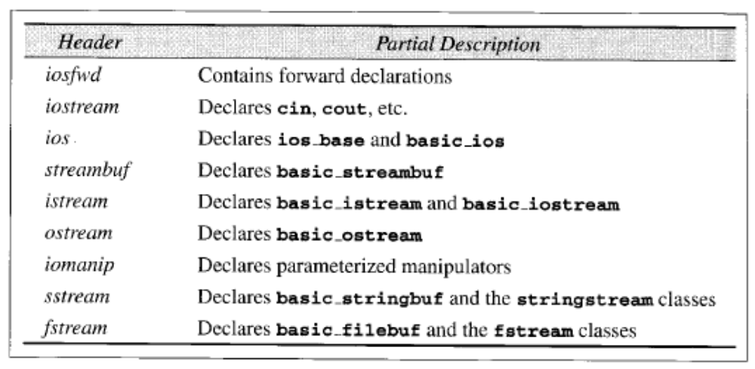
C++ Standard I/O Header Files

Slide 15
typedefs in C++ I/O
namespace std {
typedef basic_ios<char> ios;
typedef basic_streambuf<char> streambuf;
typedef basic_istream<char> istream;
typedef basic_ostream<char> ostream;
typedef basic_iostream<char> iostream;
typedef basic_filebuf<char> filebuf;
typedef basic_ifstream<char> ifstream;
typedef basic_ofstream<char> ofstream;
typedef basic_fstream<char> fstream;
typedef basic_stringbuf<char> stringbuf;
typedef basic_istringstream<char> istringstream;
typedef basic_ostringstream<char> ostringstream;
typedef basic_stringstream<char> stringstream;
typedef basic_ios<wchar_t> wios;

Slide 16
Predefined I/O Objects
Although a C++ program may read input from a variety of sources, and write output to a variety of destinations, the console keyboard and the console screen have traditionally been the source and destination (respectively) of program I/O – standard input and output respectively
C++ programs automatically provide a "standard error" object where error messages can be written, and a "standard log" where the program may write a log of whatever program activities may later be of interest.
In the simplest case all of these "output" objects are tied to the console screen, but this is only the most frequent and obvious default.
The four "Standard I/O" global objects
  cin, cout, cerr, clog
  provided by <iostream>

Slide 17
ios_base
Declares
  fmtflags format flags using bitmasks enumeration type
  methods to read, set and clear format flags
  two additional methods
    precision(...) – read/set precision
    width(...) – read/set width

Slide 18
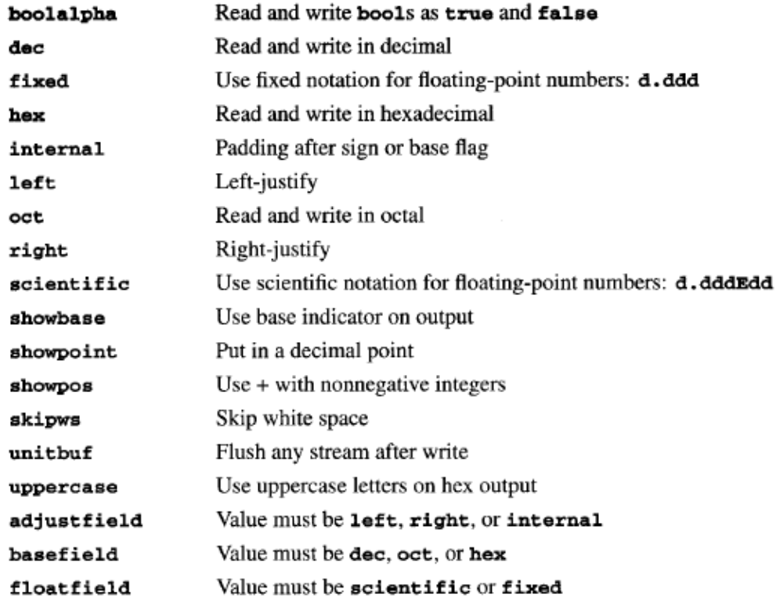
ios_base
fmtflags

Slide 19
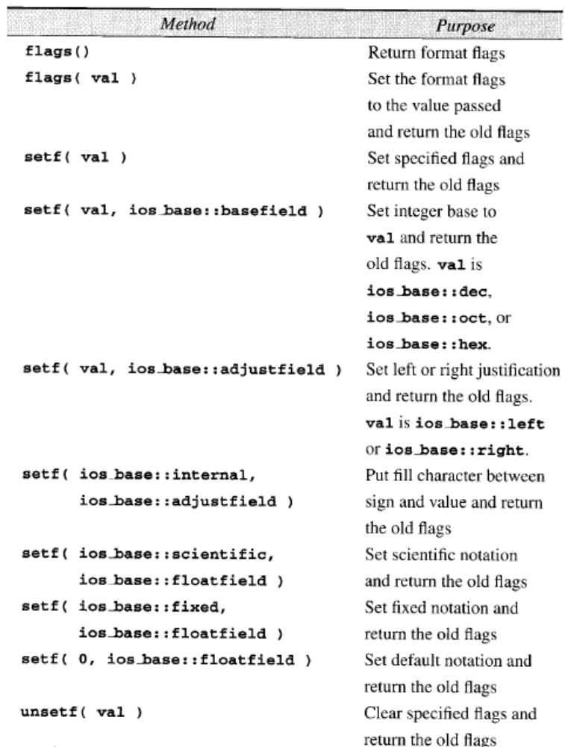
flags(...)
read fmtflags
setf(...)
set fmtflags
unsetf(...)
clear fmtflags

Slide 20
ios_base
Example – set one flag without changing others
  show the integer base, i.e.
    octal integers with a leading 0
    hexadecimal with a leading 0x
    decimal as usual
  cout.setf(ios_base::showbase); // or
  cout.flags(cout.flag() | ios_base::showbase)

Slide 21
ios_base
Example – set a single flag
  switch format as hex and oct
  cout.setf(ios_base::hex, ios_base::basefield);
  cout<< “Hex: “<<168<<‘\n’;
  cout.setf(ios_base::oct, ios_base::basefield);
  cout<< “Octal: “<<168<<‘\n’;
  Hex: a8
  Octal: 250

Slide 22
ios_base
Example – set a single flag
  switch format as hex and oct
  cout.setf(ios_base::showbase | ios_base::uppercase);
  cout.setf(iso_base::hex, ios_base::basefield);
  cout<< “Hex: “<<168<<‘\n’;
  cout.setf(iso_base::oct, ios_base::basefield);
  cout<< “Octal: “<<168<<‘\n’;
  Hex: 0XA8
  Octal: 0250

Slide 23
ios_base
Example – left and right justify
  cout.width(6);
  cout<< -100<<‘\n’; // default is right-justify
  cout.width(6);
  cout.setf(ios_base::left, ios_base::adjustfield);
  cout<< -100<<‘\n’;
  cout.width(6);
  cout.setf(ios_base::right, ios_base::adjustfield);
  cout<< -100<<‘\n’;
  //reverts to 0 (default)
  cout.setf(ios_base::right, ios_base::adjustfield);
  cout<< -100<<‘\n’;
  -100
  -100
  -100
  -100

Slide 24
ios_base
Example – clears specific flags
  cin.unsetf(ios_base::skipws);
  cin.flags(cin.flags()&(~ios_base::skipws));
// use the fill character to pad between the sign and the value
cout.width (6);
cout.setf(ios_base::internal, ios_base::adjustfield);
cout<< setfill(‘0’)<< -100<<‘\n’;
-00100
// float number in fixed and scientific notation
const float log10_pi = .497149872;
cout.setf(ios_base::scientific, ios_base::floatfield);
cout<< log10_pi<<‘\n’;
cout.setf(ios_base::fixed, ios_base::floatfield);
cout<< log10_pi<<‘\n’;
-4.971499e-001
0.497150

Slide 25
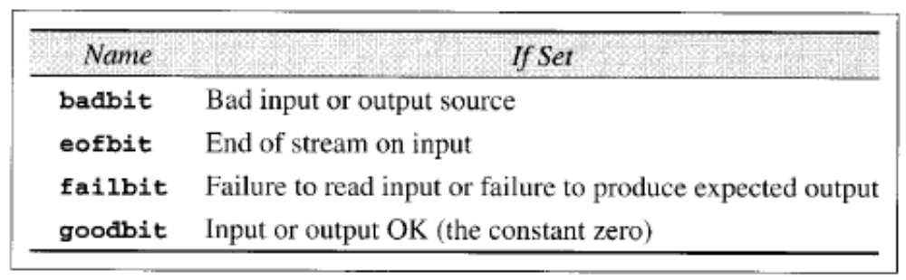
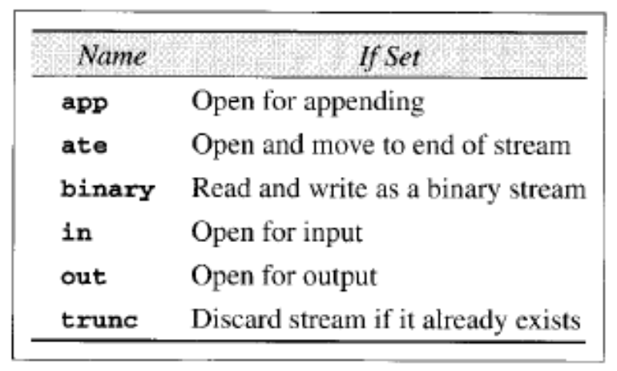
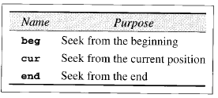
ios_base
Stream status flags
Seek flags
flags to describe the mode of an open stream

Slide 26
ios_base
// open a file stream for appending
ofstream fout(“out.dat”, ios_base::app);
// move the current position
// in the stream 10 bytes forward
out.seekp(10, ios_base::cur);
ios_base contains
  static sync_with_stdio();
  that synchronizes the C++ I/O with standard C I/O
At any time the C and C++ I/O libraries are intermixed, this method should be invoked before doing any input/output
sync_with_stdio(false); //disables synchronisation

Slide 27
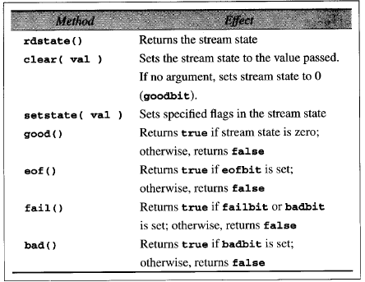
basic_ios
Methods to read, set, and clear the stream status flags

Slide 28
basic_ios
ifstream
ofstream
read
state
error
state
write
state
error
state
wrong operation
wrong operation
write
state
read
state
Any illegal operation with a stream switches it to the Error State
Once the stream is in the error state, it will stay that way. All subsequent operations will do nothing, no matter what they are or what is in the input.

Slide 29
basic_ios
// read the current status of cin
ios_base::iostate cur_state = cin.rdstate();
// iostate is a bitmasktype
// echoes integers in the standard input to the standard output,
// one per line.
// assume that a newline follows the last integer in the input
// which segment is correct or both are correct?
// code 1
int i
do {
cin >> i;
if (!cin.eof()) cout<<i<<‘\n’;
} while (!cin.eof());
// code 2
int i;
while (!cin.eof()) {
cin>>i;
cout<< i<<‘\n’;
}
eof bit set here

Slide 30
basic_ios
Specify and use exceptions
  basic_ios has a method exceptions. It can be used to specify that certain i/o conditions throw exceptions.
  when the argument is eofbit, badbit, failbit, or a combination of these bits using | (or), if an error of the type specified occurs, an exception of type ios_base::failure is thrown.
  to deactivate throwing the i/o exception, call exceptions method with goodbit as the argument.
        try {
        cout.exceptions(ios_base::failbit);
        cout<<“Boola, boola!\n”;
        } catch (ios_base::failbit) {
        cerr<<“Failed output\n”;
        //...
        }

Slide 31
basic_istream
    namespace std
    {
    template <class charT, class traits = char_traits<charT> >
    class basic_istream
    :virtual public basic_ios<charT, traits>
    {
    // ...
    };
    }
basic_ios
basic_istream
basic_ostream
basic_iostream

Slide 32
basic_istream
Methods for input stream
  Read one character
    basic_istream<charT, traits>& get(char_type& c);
  Read one line
    basic_istream<charT, traits>& getline( char_type *b, streamsize s, char_type d);
  Read a block of bytes in binary
    basic_istream<charT, traits>& read(char_type* a, streamsize n);
  Check next character in the input stream
    int_type peek();
  Put a character back to the input stream
    basic_istream<charT, traits>& putback(char_type c);

Slide 33
basic_istream
Methods for input stream continue....
  Remove characters from the input stream
    basic_istream<charT, traits>& ignore(int count = 1, int_type stop);
  Returns the number of characters read by the last unformatted input method
    streamsize gcount() const;
  Moving around in the input stream
    basic_istream<charT, traits>& seekg( off_type off, ios_base::seek_dir dir);
    pos_type tellg();
    basic_istream<charT, traits>& seekg( pos_type pso);
  overloaded operator >> for built-in types
    basic_istream<charT, traits>& operator>>(built_in_type& );

Slide 34
basic_istream
Methods for input stream when charT is char
  istream& get(char& c);
  int get();
  stream& getline(char* s, int size, char c=‘\n’);
  istream& read(char* a, int n);
  int peek();
  istream& putback(char c);
  istream& ignore(int count = 1, char c=‘\n’);
  istream& seekg(int off, seekdir);
  int tellg();

Slide 35
basic_istream
Echo the standard input to the output
char c;
cin.setf(ios_base::skipws);
while (cin >> c)
cout<< c;
cout << ‘\n’;
Input: x y z
Output: xyz
  char c;
  cin.unsetf(ios_base::skipws);
  while (cin >> c)
  cout<< c;
  cout << ‘\n’;
  Input: x y z
  Output: x y z

Slide 36
basic_ostream
namespace std
{
template <class charT, class traits = char_traits<charT>>
class basic_ostream
:virtual public basic_ios<charT, traits>
{
// ...
};
}

Slide 37
basic_ostream
Methods for output stream
  Put one character
    basic_ostream<charT, traits>& put(char_type c);
  Write a block of bytes in binary
    basic_ostream<charT, traits>& write(char_type* a, streamsize m);
  Moving around in the input stream
    basic_ostream<charT, traits>& seekp( off_type off, ios_base::seek_dir dir);
    pos_type tellp();
    basic_ostream<charT, traits>& seekp( pos_type pso);
  flush the output buffer
    basic_ostream<charT, traits>& flush();
  overloaded operator >> for built-in types
    basic_istream<charT, traits>& operator<<(built_in_type& );

Slide 38
basic_ostream
Methods for output stream when charT is char
  ostream& put(char c);
  istream& write(char* a, int m);
  istream& flush();
  istream& seekp(int off, seekdir);
  int tellp();

Slide 39
basic_iostream
namespace std
{
template <class charT, class traits = char_traits<charT>>
class basic_iostream :
public basic_istream<charT, traits>,
public basic_ostream<charT, traits>
{
public:
. . . .
};
typedef basic_iostream<char> iostream;
}

Slide 40
basic_iostream
seekp()
read
state
write
state
seekg()
error
error
state
error
Why input failure affects output too?

Slide 41
Manipulators
A manipulator is a function that either directly or indirectly modifies a stream.
C++ defines two types of manipulators
  those without arguments
  those with arguments.
    need to include <iomanip> header
Use of manipulators
    cout<<manipulator; // or
    cin>>manipulator;

Slide 42
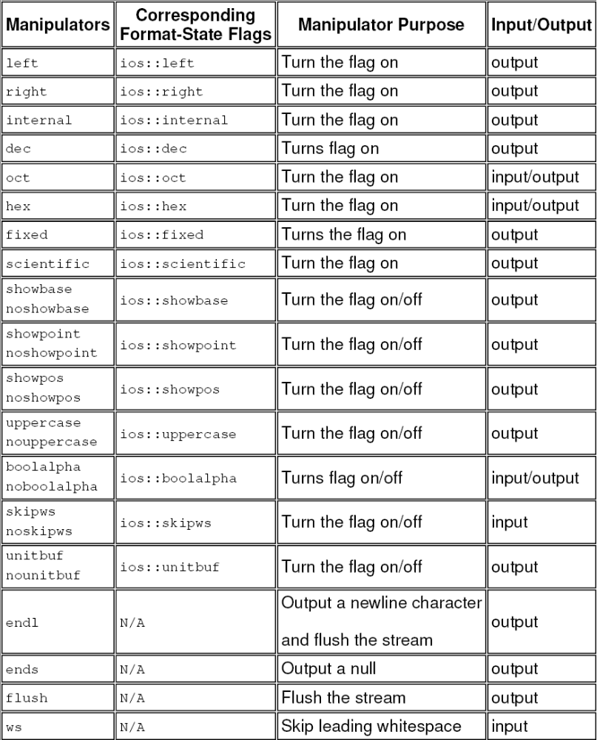
Manipulators without arguments

Slide 43
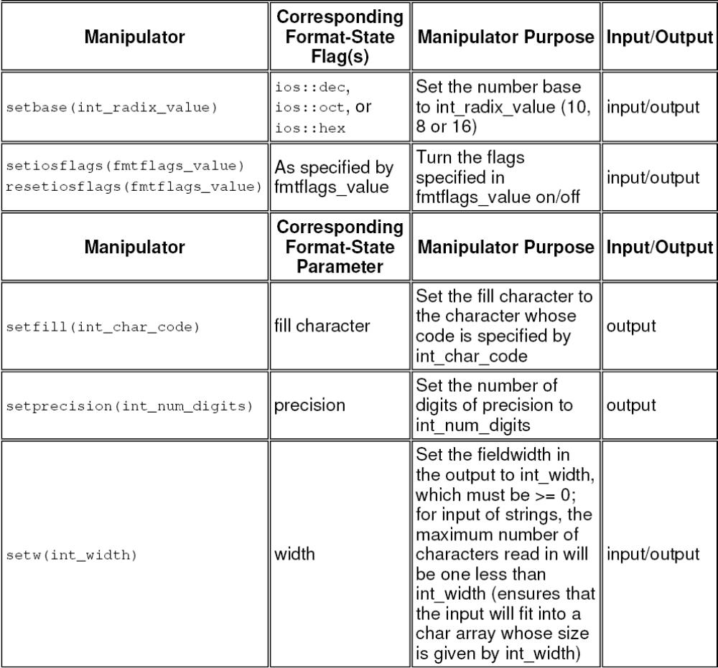
Manipulators with
Arguments

Slide 44
Manipulators
We can rewrite using manipulators the previous example in which the output shows the base, and uppercase letters are used on hexadecimal output
  cout<<setiosflags(ios_base::showbase | ios_base::uppercase)
  << hex << “Hex: “<<168<<endl
  << oct << “Octal: “<<168<<endl;

Slide 45
Write your own manipulators
Considering
    cout<<endl;
  is equivalent to
    cout.operator<<(endl);
endl is referenced as the name of a function of type “pointer to a function with one argument of type basic_ostream& that returns type basic_ostream&
In other words, the prototype of the endl function is
  ostream& endl(ostream& os)
  {
  // os<< ‘\n’;
  // return os.flush();
  }

Slide 46
Write your own manipulators
In fact, basic_ostream contains following declaration
  basic_ostream<charT,traits>& operator<< (basic_ostream<charT,traits>& (*f)(basic_ostream<charT,traits>&))
  {
  return f(*this)
  };
where f is f type “pointer to a function with one argument of type basic_ostream& that returns type basic_ostream&
In practice, f is a pointer to a manipulator. The method operator<< simply invoke the manipulator to which f points

Slide 47
Write your own manipulators
//
// Rewrite endl manupilator
//
#include <iostream>
using namespace std;
ostream& endl(ostream& os)
{
os<<"This is my endl !"<<'\n';
return (os.flush());
}
int main()
{
cout << endl;
return 0;
}
Output:
This is my endl !
//
// bell manupilator
//
#include <iostream>
using namespace std;
// rings the bell
ostream& bell(ostream& os)
{
return (os<<‘\a’);
}
int main()
{
cout << bell;
return 0;
}

Slide 48
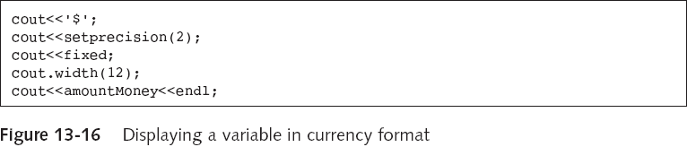
Write your own manipulators
The following code displays a variable in currency format with a dollar sign in a field size of twelve

Slide 49
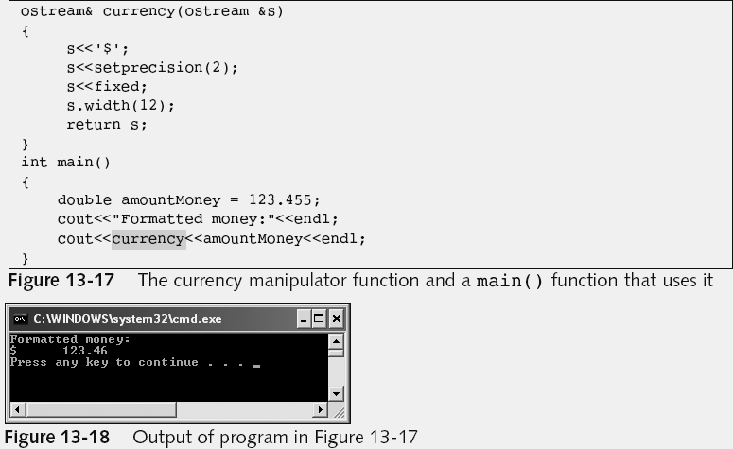
Write your own manipulators

Slide 50
Write your own manipulators
Consider we want a manipulator, bell(n), that rings the bell n times.
    cout << bell(10); // rings the bell 10 times
  since the function operator () has greater precedence than <<, when this statement is executed, the function bell is invoked with argument 10, after which operator<< is invoked as
    operator<<(cout,val);
  where val is the value returned by bell. An appropriate << will be invoked based on the type of val.

Slide 51
Write your own manipulators
The header iomanip normally includes a class/struct omanip similar to the following that facilitates writing one-argument manipulators.
  template<class Typ, class charT, class traits=char_traits<charT> >
  struct omanip
  {
  Typ n;
  void (*f) (basic_ostream<charT, traits>&, Typ);
  omanip(void (*f1)(basic_ostream<charT, traits>&, Typ), Typ n1):f(f1),n(n1) {}
  };
  and the overload of <<
  template<class charT, class traits, class Typ>
basic_ostream<charT, traits>& operator<<(
basic_ostream<charT,traits>& os, const omanip<Typ, charT>& sman)
{
  (sman.f)(os,sman.n);
  return os;
  }

Slide 52
Write your own manipulators
Parameterized type Typ describes the type of the manipulator’s argument
f1 is a pointer to a secondary function that actually modifies the stream and n1 is the argument to f1
The constructor simply initializes the members to the arguments passed to it.
The function operator<< invokes the function that modifies the stream.

Slide 53
Write your own manipulators
We write the secondary bell ringer function as
    void bell_ringer(ostream& os, int n)
    {
      for(int i=0; i<n; i++)
        os<<“\a”;
    }
  and the bell manipulator as
    omanip<int, char> bell(int n)
    {
      return omanip<int,char>(bell_ringer,n);
    }
    cout<<bell(10);
  is equivalent to
    operator<<(cout, bell(10));

Slide 54
// bell(n) manipulator
#include <iostream>
#include <iomanip>
using namespace std;
template<class Typ, class charT, class traits=char_traits<charT> >
struct omanip
{
Typ n;
void (*f) (basic_ostream<charT, traits>&, Typ);
omanip(void (*f1)(basic_ostream<charT, traits>&, Typ), Typ n1):f(f1),n(n1) {}
};
template<class charT, class traits, class Typ>
basic_ostream<charT, traits>& operator<<( basic_ostream<charT,traits>& os, const omanip<Typ, charT>& sman)
{
(sman.f)(os,sman.n);
return os;
}
void bell_ringer(ostream& os, int n)
{
for(int i=0; i<n; i++)
os<<"a ";
}
omanip<int,char> bell(int n)
{
return omanip<int, char>(bell_ringer,n);
}
int main()
{
cout<<bell(10)<<endl;
return 0;
}

Slide 55
Stream Classes for Strings
ios_base
has-a
basic_streambuf
basic_ios
basic_istream
basic_ostream
basic_ifstream
basic_ofstream
basic_iostream
basic_istringstream
basic_ostringstream
cin cout, cerr, clog
basic_stringstream
basic_fstream

Slide 56
Stream Classes for Strings
In-Memory String I/O
  basic_stringbuf,
  basic_ostringstream,
  basic_istringstream,
  basic_stringstream
  reads / writes characters from/to an internal buffer.

Slide 57
basic_ostringstream
A template class derived from basic_ostream
    namespace std
    {
    template<class charT,
    class traits = char_traits<charT>,
    class Allocator = allocator<charT> >
    class basic_ostringstream: public basic_ostream<charT, traits>
    {
    // ...
    };
    }
  constructors
    explicit basic_ostringstream( ios_base::openmode mode=ios_base::out);
    explicit basic_ostringstream( const basic_string<charT, traits, Allocator>& s, ios_base::openmode mode=ios_base::out);
  inherits methods from basic_ostream to write and move within the internal buffer

Slide 58
basic_ostringstream
Examples
  ostringstream sout;
  create an ostringstream object sout. the internal buffer is not initialized.
  string name=“”;
  ostringstream sout(name);
  create an ostringstream object sout and initialize sout’s internal buffer to

Slide 59
basic_ostringstream
Methods to access the buffer
  string str() const; // returns a string that is a copy of the buffer
  void str(const string & s); // replace the internal buffer’s content with s
Example
  int i=15;
  ostringstream sout;
  sout<<“Address: “<< i<< “ Philip St”;
  string s= sout.str();
  cout<<s<<‘\n’; // or cout<< sout.str() << endl;
  output: Address: 15 Philip St

Slide 60
basic_istringstream
A template class derived from basic_istream
    namespace std
    {
    template<class charT,
    class traits = char_traits<charT>,
    class Allocator = allocator<charT> >
    class basic_istringstream: public basic_istream<charT, traits> {
    // ...
    };
    }
  constructors
    explicit basic_istringstream ( ios_base::openmode mode=ios_base::in);
    explicit basic_istringstream ( const basic_string<charT, traits, Allocator>& s, ios_base::openmode mode=ios_base::in);
  inherits methods from basic_istream to read and move within the internal buffer

Slide 61
basic_istringstream
Examples
  istringstream sin;
  create an istringstream object sin. the internal buffer is not initialized.
  float x;
  string val=“37.805”;
  istringstream sin(val);
  sin >> x;
  create an istringstream object sin and initialize sin’s internal buffer to 37.805
  read the value 37.805 from sin to x

Slide 62
basic_istringstream
Examples
  char c;
  string s = “abcde”;
  istringstream sin(s);
  while(sin.good())
  {
  sin>>c;
  cout<< “Input: ”<<c<<endl;
  }
  cout<<“at the end of string”<<endl;
  Input: a
  Input: b
  Input: c
  Input: d
  input: e
  at the end of string

Slide 63
basic_stringstream
A template class derived from basic_iostream
    namespace std
    {
    template<class charT,
    class traits = char_traits<charT>,
    class Allocator = allocator<charT> >
    class basic_stringstream: public basic_iostream<charT, traits>
    {
    // ...
    };
    }
  constructors
    explicit basic_stringstream ( ios_base::openmode mode=ios_base::in|ios_base::out);
    explicit basic_stringstream ( const basic_string<charT, traits, Allocator>& s, ios_base::openmode mode=ios_base::in|ios_base::out);
  inherits methods from basic_iostream to read, write and move within the internal buffer

Slide 64
Example
High-Level Copy Function
  write a template function, say, copy, that copies an arbitrary basic_istream object to an arbitrary basic_ostream object
  e.g.
    cin->cout
    ifstream -> ofstream
    istringstream ->ofstream

Slide 65
Example
#include <iostream>
using namespace std;
// copy from basic_istream to basic_ostream
template< class charT, class traits>
void copy( basic_istream<charT, traits>& in,
basic_ostream<charT, traits>& out )
{
charT c;
ios_base::iostate fl;
fl = in.flags(); // save old flags in fl to restore at end
in.unsetf( ios_base::skipws ); // don't skip white space
while ( in >> c )
out << c;
// restore flags
in.flags( fl );
}

Slide 66
Example
// copy std input to std output
int main()
{
copy(cin, cout);
return 0;
}
// copy file data.in to data.out
int main()
{
ifstream fin(“data.in”);
ofstream fout(“data.out”);
copy(fin, fout);
....
return 0;
}
// copy a string to file data.out
int main()
{
string s = “......”;
istringstream sin(s);
ofstream fout(“data.out”);
copy(sin, fout);
....
return 0;
}

